Slide 1
GSE Loan Level Credit Modeling
April 2015

Slide 2
Outline
Introduction
Description of Data
Description of Framework
Model Iteration Process
Results/Examples
Model Specification
Regression Results
Fitting Charts
Projections
Going Forward – running STACR/CAS bonds

Slide 3
Introduction
Modeling loan level transition rates is a process of extracting useful information from potentially a vast amount of data. Using statistical analysis, we can hope to gain useful information without relying on market prices or personal opinion.
The goal, more precisely, is to quantify the sensitivity of transitions to the myriad of different variables that could potentially influence the transition rates. For example, what impact does FICO > 700 have on the transition rate from AC (always current) to 30 days delinquent? Does the FICO effect depend on the age of the loan?
With clean data and a platform for its analysis, we can hope to answer many questions about the sensitivities of transition rates.
Successful transition modeling at the loan level requires several components:
Clean data with information at the start and throughout the life of the loans
Flexible platform:
Define possible transitions and variables influencing transitions
Iteratively revise model specifications
Report significance and impact of variables
Fitting module for comparing model to actual historically
Forward projections
Integration of model into pricing platforms

Slide 4
Description of Data
Fannie Mae and Freddie Mac make available loan level data for ~21MM loans and ~17MM loans respectively. All loans are 30 Year Fixed, Full Doc mortgages, originated after 1999
The GSE data consist of 2 tables:
A static table of origination information: FICO, LTV, DTI, Original Bal, etc.
A dynamic table of historical performance: Status, Current Coupon, Current Balance, etc.
The dynamic data is updated quarterly and has data through Mar 2014 (Freddie) and Sep 2014 (Fannie)
Additionally there is a lag between the acquisition of new loans and their availability in the GSE data. Currently we have data for loans originated up to Q4 of 2013.
The GSE data is cleaned and loaded into Cello tables in the IQ database. The cleaning and loading process supplements the data with additional fields: Current HPA, Periods Since Last Delinquent, Modification Count, etc.
Subsets of the GSE data are pulled from the IQ database for our modeling efforts

Slide 5
Example Data
Origination Data
loanID | vintage | origCoupon | origBalance | origLTV | origDTI | origFICO | loanPurpose | occupancyStatus | channel
100007365142 | 2000 | 8 | 75000 | 79 | 62 | 763 | RE-FI-NCO | OWNER | RETAIL
100011322040 | 2000 | 7.75 | 123000 | 80 | 28 | 750 | PURCH | OWNER | CORRES
100015192562 | 2000 | 8.5 | 51000 | 95 | 27 | 686 | PURCH | OWNER | RETAIL
100015874399 | 2000 | 8.75 | 242000 | 95 | 47 | 706 | PURCH | OWNER | CORRES
100017922445 | 2000 | 8.25 | 240000 | 77 | 19 | 737 | PURCH | OWNER | CORRES
100020205696 | 1999 | 7.625 | 225000 | 64 | 21 | 793 | PURCH | OWNER | RETAIL
100021703104 | 2000 | 8 | 120000 | 75 | 36 | 750 | PURCH | OWNER | CORRES
Performance Data
loanID | beginDate | beginCpn | beginBalance | diffBalance | beginStatus | endStatus | HPA | modCount | ageSinceLastCurrent
177982109065 | 1/1/2013 | 3.99 | 343503.46 | -498.17 | C | 30 | 1.0097 | 0 | 0
177982109065 | 2/1/2013 | 3.99 | 343005.29 | -499.84 | 30 | 60 | 1.0153 | 0 | 1
177982109065 | 3/1/2013 | 3.99 | 342505.45 | -501.49 | 60 | 60 | 1.0209 | 0 | 2
177982109065 | 4/1/2013 | 3.99 | 342003.96 | -503.17 | 60 | 30 | 1.0315 | 0 | 3
177982109065 | 5/1/2013 | 3.99 | 341500.79 | -504.83 | 30 | 60 | 1.0421 | 0 | 4
177982109065 | 6/1/2013 | 3.99 | 340995.96 | 1380.85 | 60 | 90 | 1.0527 | 0 | 5
177982109065 | 7/1/2013 | 3.99 | 342376.81 | -503.71 | 90 | 90 | 1.0641 | 0 | 6
177982109065 | 8/1/2013 | 3.99 | 341873.1 | 0 | 90 | 120 | 1.0755 | 0 | 7
177982109065 | 9/1/2013 | 3.99 | 341873.1 | -505.38 | 120 | 120 | 1.0869 | 0 | 8
177982109065 | 10/1/2013 | 3.99 | 341367.72 | 0 | 120 | 150 | 1.0962 | 0 | 9
177982109065 | 11/1/2013 | 3.99 | 341367.72 | 3812.77 | 150 | C | 1.1056 | 0 | 10
177982109065 | 12/1/2013 | 4 | 345180.49 | 0 | C | 30 | 1.115 | 1 | 0
177982109065 | 1/1/2014 | 4 | 345180.49 | -587.5 | 30 | C | 1.1214 | 1 | 1

Slide 6
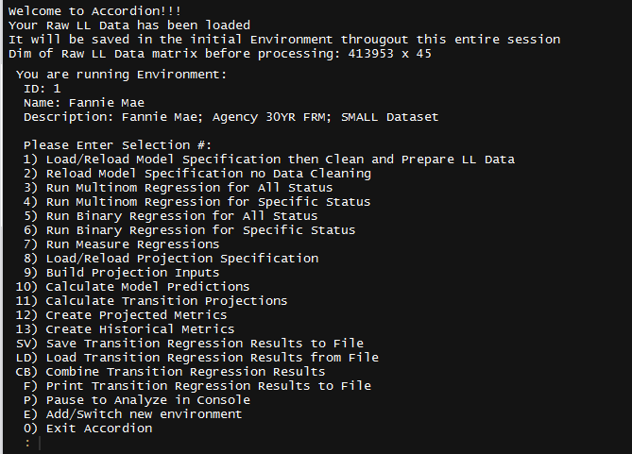
Description of Framework - Accordion
Accordion is a platform written in R that allows for:
Specification: flexible and fast specification and estimation of transition models
Fitting: testing the fit when run historically and comparing this to actual data
Projections: calculate estimates forward through time on any set of loans and to bucket the results for easy analysis

Slide 7
Transition Model Specification: Initial Specification
Flexible Status and Transition Definitions
GSE Status | # Past Delinquencies | Model Status | Short Name
C | 0 | Always Current | AC
C | >=1 | Dirty Current | DC
30 | - | Early Delinquent | ED
60 | - | Late Delinquent | LD
90 | - | Late Delinquent | LD
120 | - | > 90 Day Delinquent | N
150 | - | > 90 Day Delinquent | N
X | - | Loan Exits Pool | Out
 |  | To
 |  | AC | DC | ED | LD | N | Out
From | AC | ✓ |  | ✓ |  |  | ✓
 | DC |  | ✓ | ✓ |  |  | ✓
 | ED |  | ✓ | ✓ | ✓ |  | ✓
 | LD |  | ✓ | ✓ | ✓ | ✓ | ✓
 | N |  | ✓ | ✓ | ✓ | ✓ | ✓
 | Out |  |  |  |  |  | ✓
Transition Metrics
From | AC | DC | ED | LD | N | LD | N | AC | DC | ED
To | Out | Out | Out | Out | Out | DC | DC | ED | ED | DC
Result | Prepay | Prepay | Prepay | Default | Default | Mod | Mod | AC->DQ | DC->DQ | Cure
Variable Definitions
Variable | Type | Definition
Orig DTI | Numeric | origDTI
Coupon | Numeric | beginCoupon
Occupany Status | Factor | occupanyStatus = {‘Owner’,’Investor’,’Second’}
Refinance Incentive | Formula | (beginCoupon - fhl30_rate) * 100
Loan Age Bucket | Bucket | {'loanAge_0_24', 'loanAge_24_48', 'loanAge_gt_48}

Slide 8
Transition Model Specification: An Iterative Process
Specifying a Transition Model is the goal of Accordion. To accomplish this the user will find the process fast and intuitive:
Step 1: Load a subset of GSE Loan Level data ~200K loans
ex) Always Current or Early Delinquent loans
Step 2: Refine Transition Specification
Add variables that make sense: FICO, loanAge interactions, etc
Remove variables that are not significant or that don’t make sense
Step 3: Run regressions and save results to file
Step 4: Repeat the process with a different subset of loans
Step 5: Once all transitions in the specification have been refined and estimated, then combine the results into one specification for fit testing
Step 6: Test the historical fit of the model over known data (Actual vs Model)
Step 7: Go back to Step 1 to refine the model for areas of poor tracking

Slide 9
Transition Model Specification: Example Results
Transition Specification: Variables by Beginning Status
Variables | AC | DC | ED | LD | N
refi_incentive_func : loanAge_bucket | ✓
origFICO | ✓ | ✓ | ✓ | ✓ | ✓
pmin(pmax(mtm_cltv, XX), XX) | ✓ | ✓ | ✓ | ✓ | ✓
occupancyStatus_factor | ✓ | ✓ | ✓ | ✓ | ✓
loanPurpose_factor | ✓ | ✓ | ✓ | ✓ | ✓
pmin(pmax(origBalance/XX, XX), XX) | ✓ | ✓
modificationCount |  | ✓
refi_incentive_func (2 month lag) |  | ✓
loanAge_bucket |  | ✓ | ✓ | ✓
countNonCurrent |  |  | ✓
Transition Specification: Regression Results (Status = 90+)
 | Intercept | origFICO | pmin(pmax(mtm_cltv, 50), 140) | occupancyStatus_factor : INV | occupancyStatus_factor : 2ND | loanPurpose_factor : RE-FI-NCO | loanPurpose_factor : RE-FI-CO
DC | 0.817 | 0.998 | 0.991 | 0.457 | 0.435 | 0.970 | 1.074
ED | 0.026 | 1.001 | 0.990 | 0.338 | 0.000 | 0.729 | 0.754
LD | 0.595 | 0.998 | 0.988 | 0.723 | 0.874 | 0.902 | 0.756
Out | 0.261 | 1.001 | 1.002 | 1.281 | 1.336 | 1.013 | 0.938
1 pt increase in mtm_cltv will reduce the transition from 90+ to Current, Early DQ, Late DQ. It will slightly increase the transition rate to X = Default
occupancyStatus Investor reduces the transition from 90+ to Current, Early DQ, Late DQ vs Owner. It increases the transition rate to X = Default

Slide 10
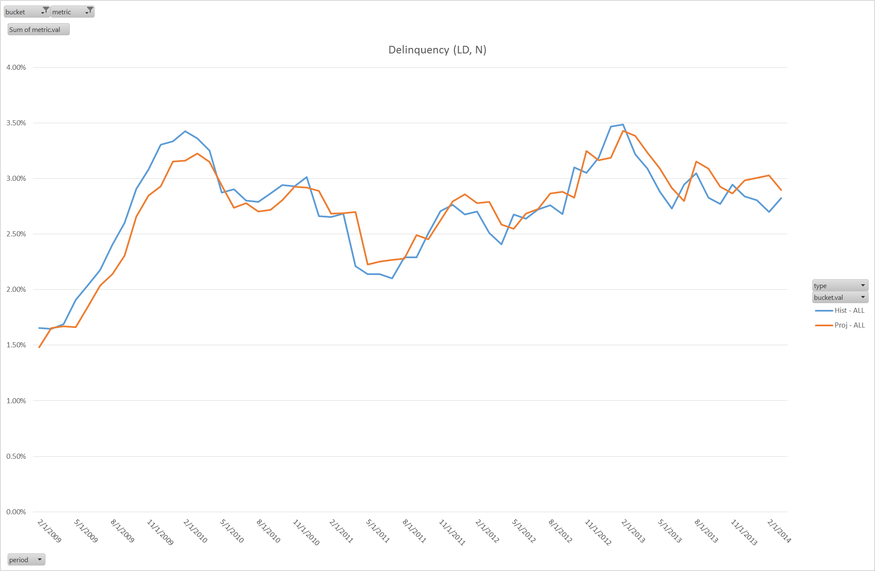
Model Fit: Actual vs Model
1 Month Historical Projections:
Loan characteristics reset for each period

Slide 11
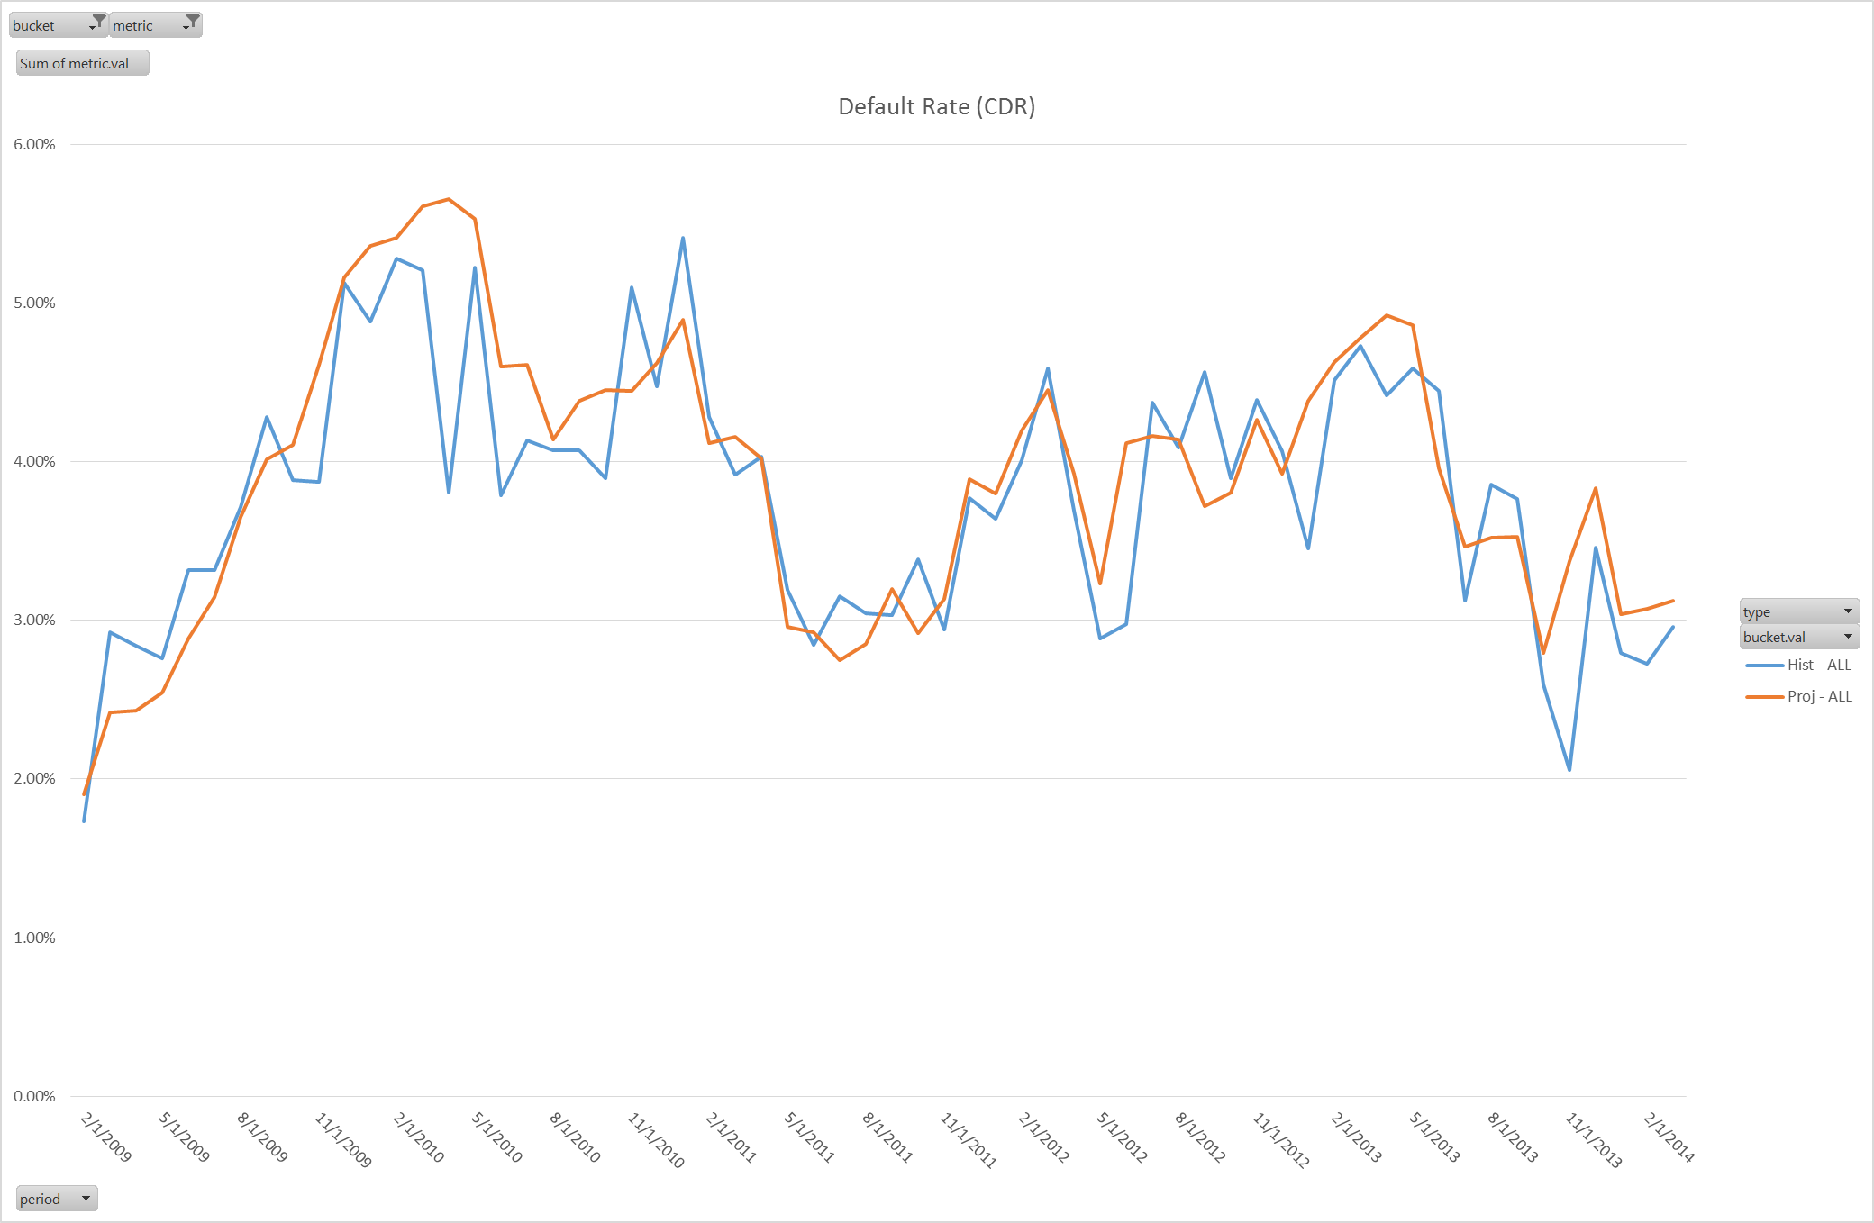
Model Fit: Actual vs Model
Metric output is Balance Weighted

Slide 12
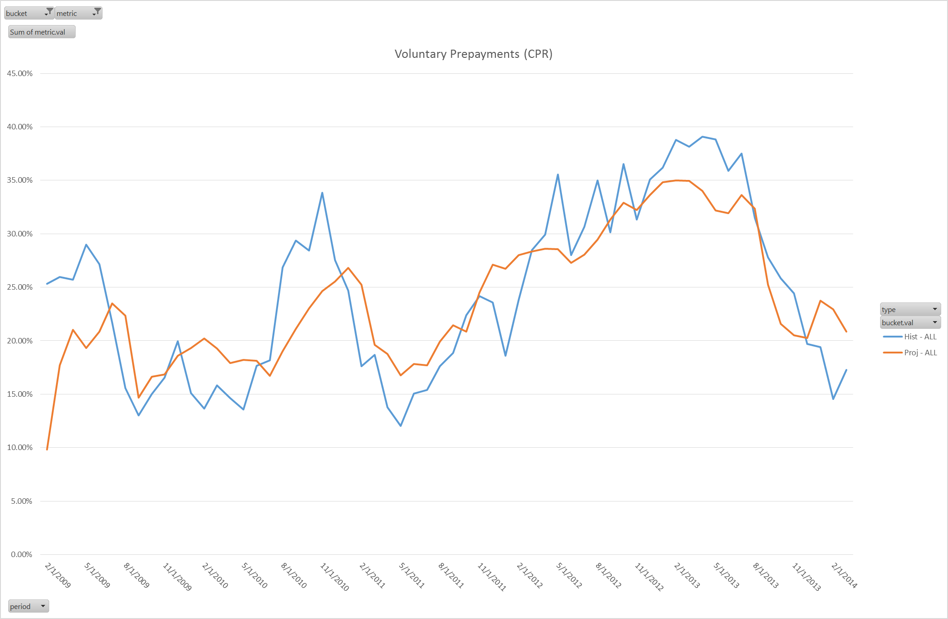
Model Fit: Actual vs Model
Historical mortgage rates (lagged by 2 months) are used in the fitting projections

Slide 13
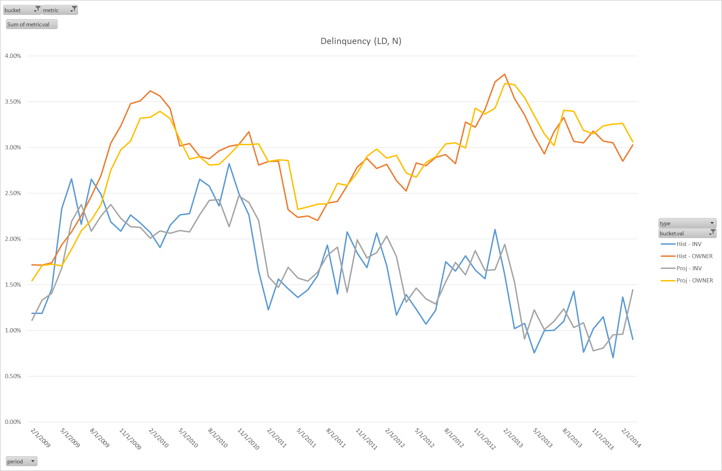
Model Fit: Actual vs Model (bucket by Occupancy)
Owner
Investor

Slide 14
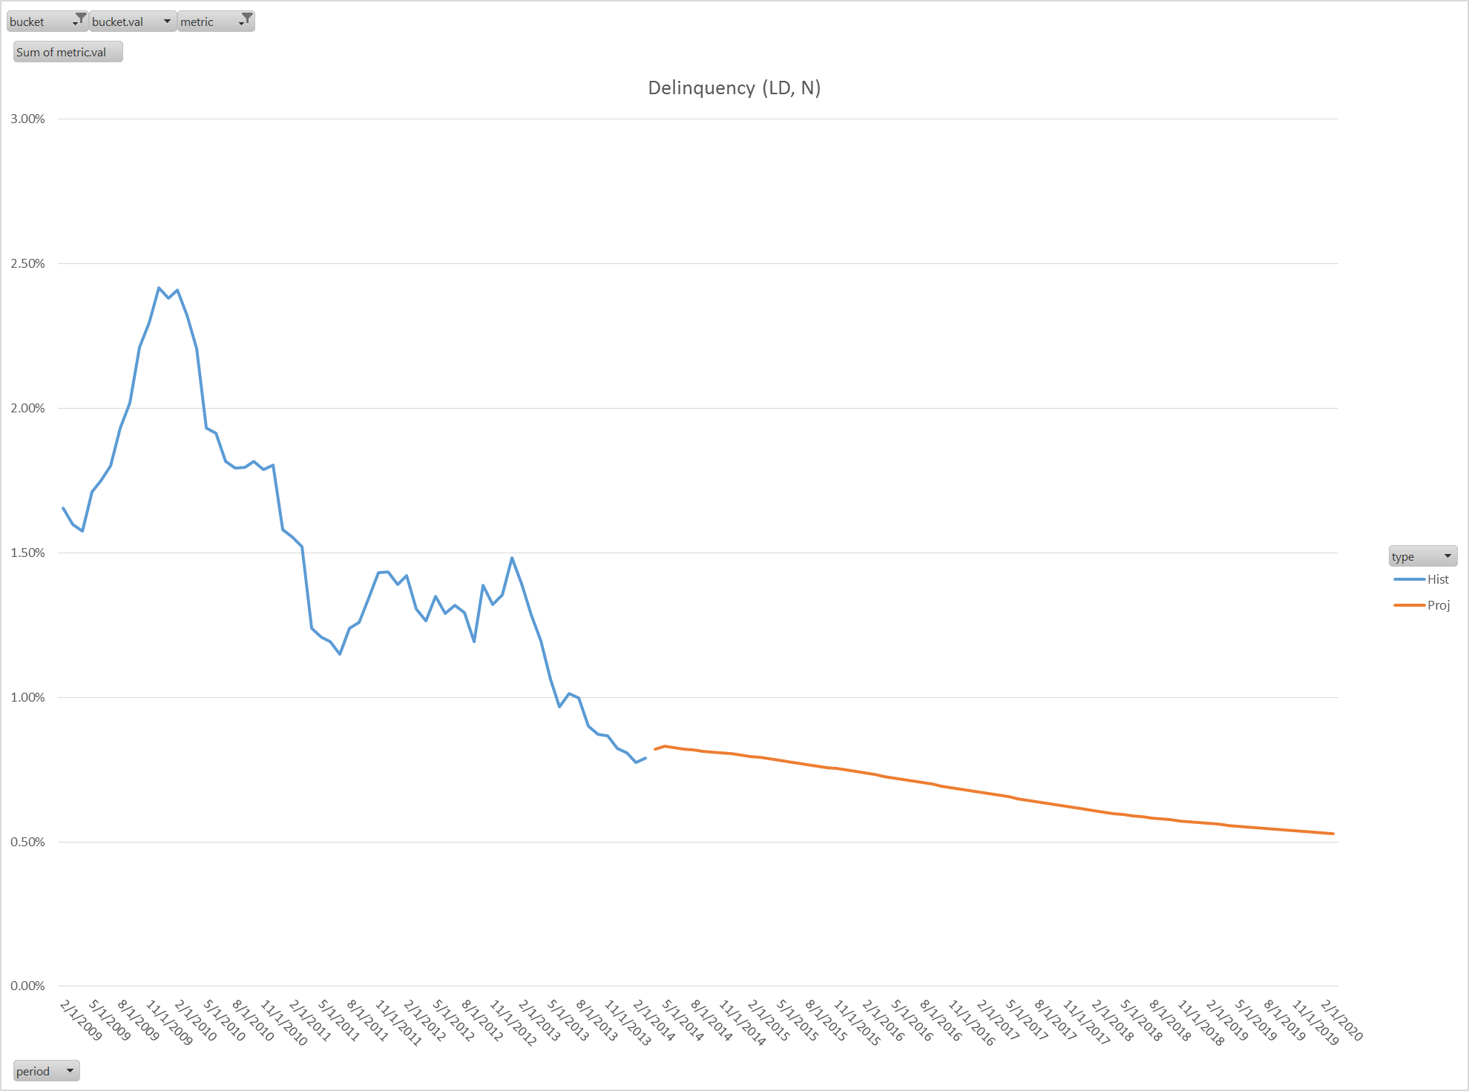
Model Projections
Forward projections use last known loan characteristics and projections of macro variables (HPA, Rates, etc.)

Slide 15
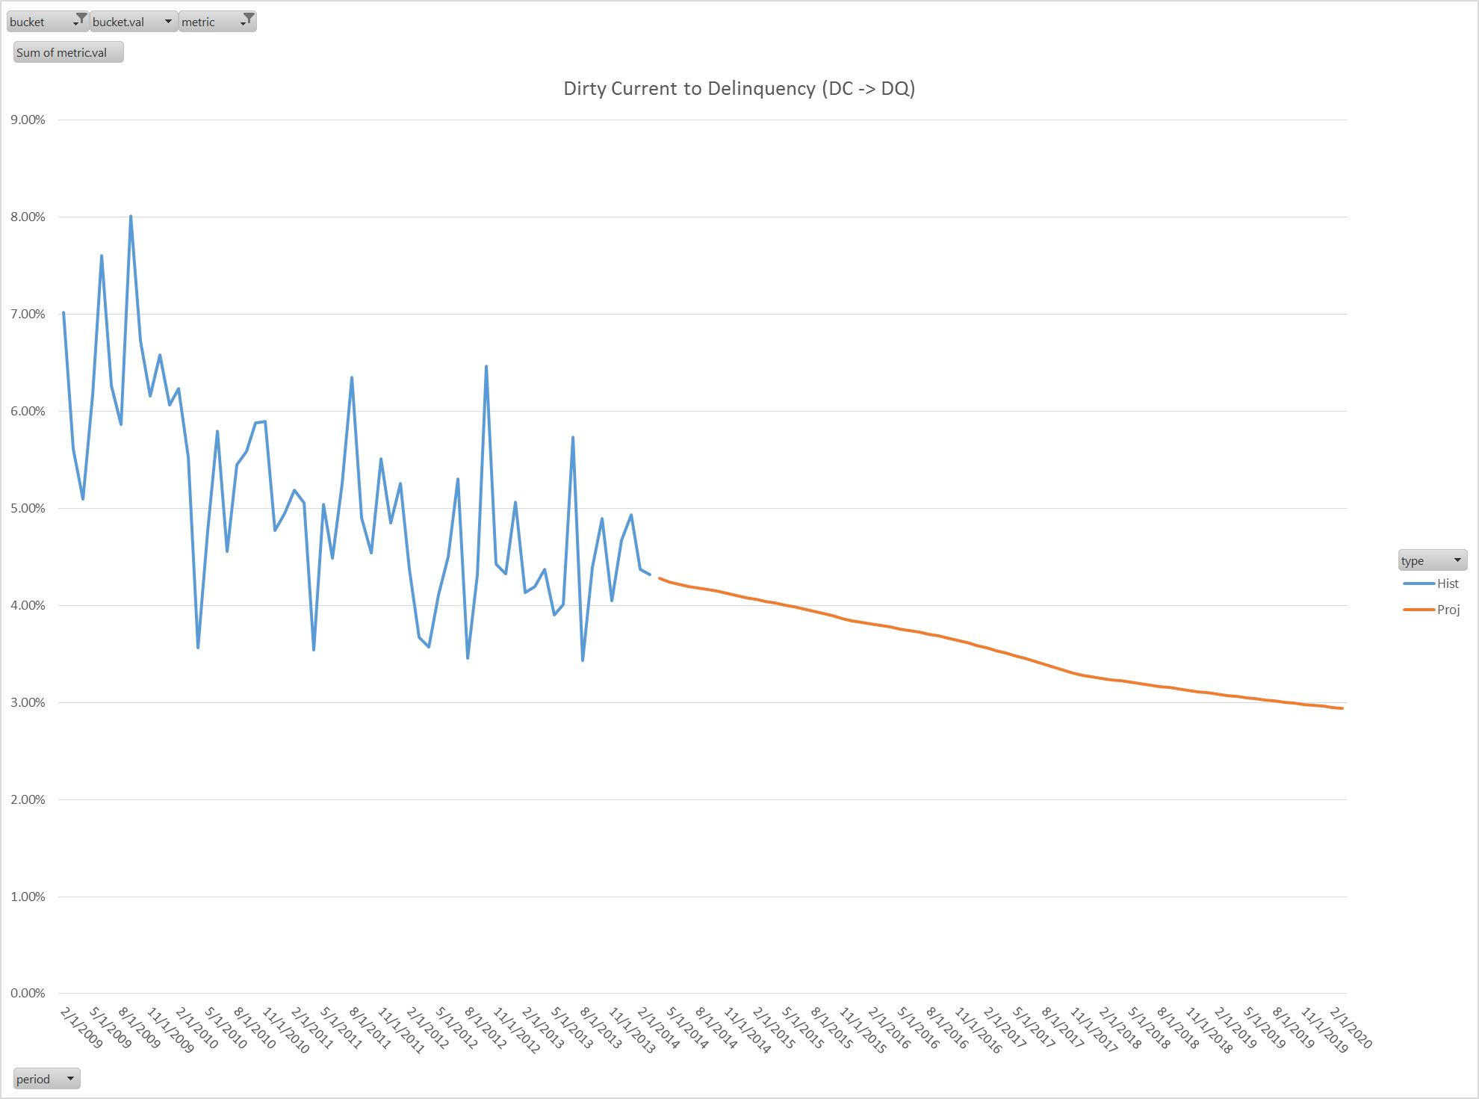
Model Projections
Transition rates to delinquency decay over time: HPA increase, burnout

Slide 16
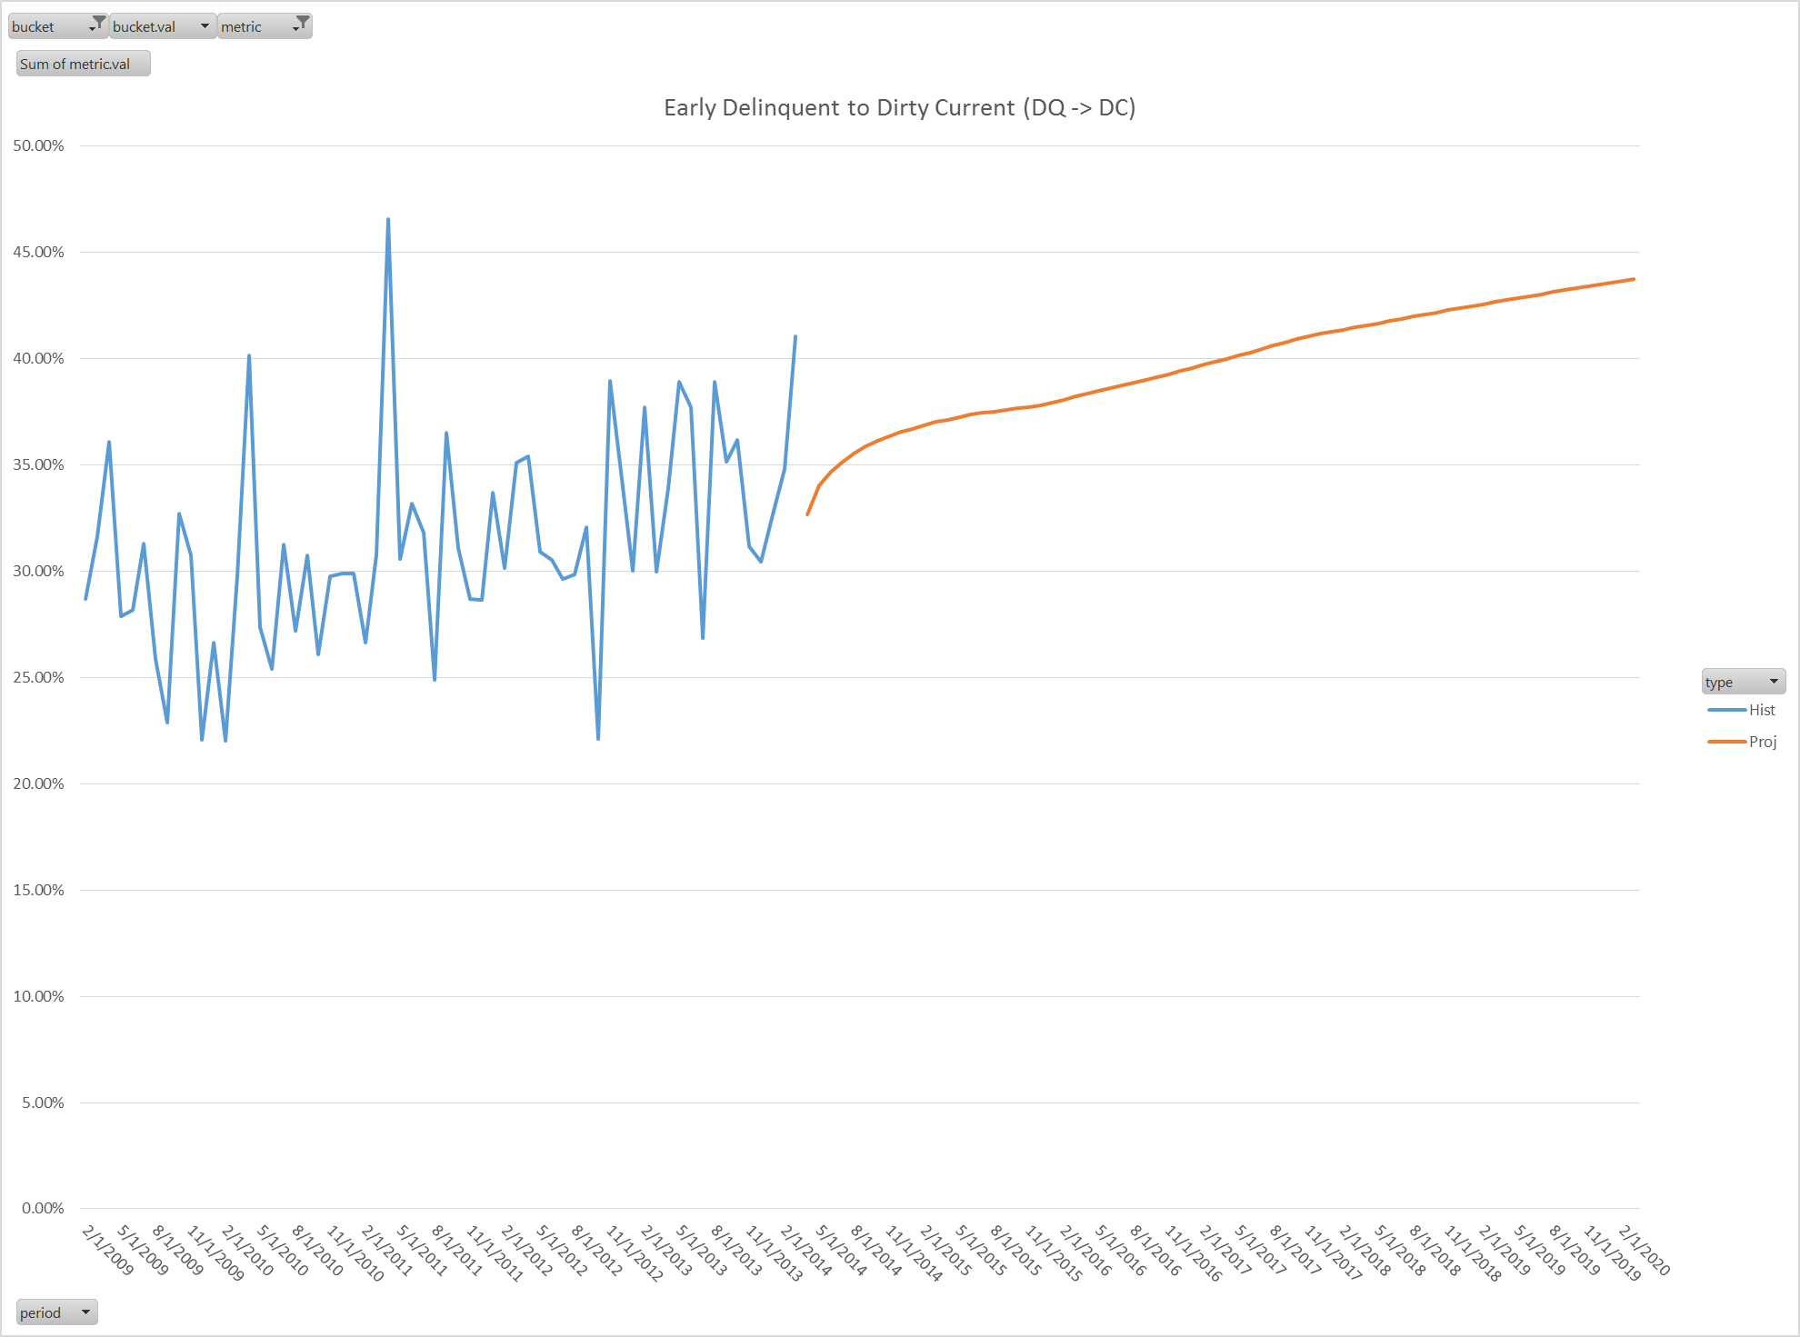
Model Projections
Cure rates increase over time: HPA increases, MTM LTV decreases

Slide 17
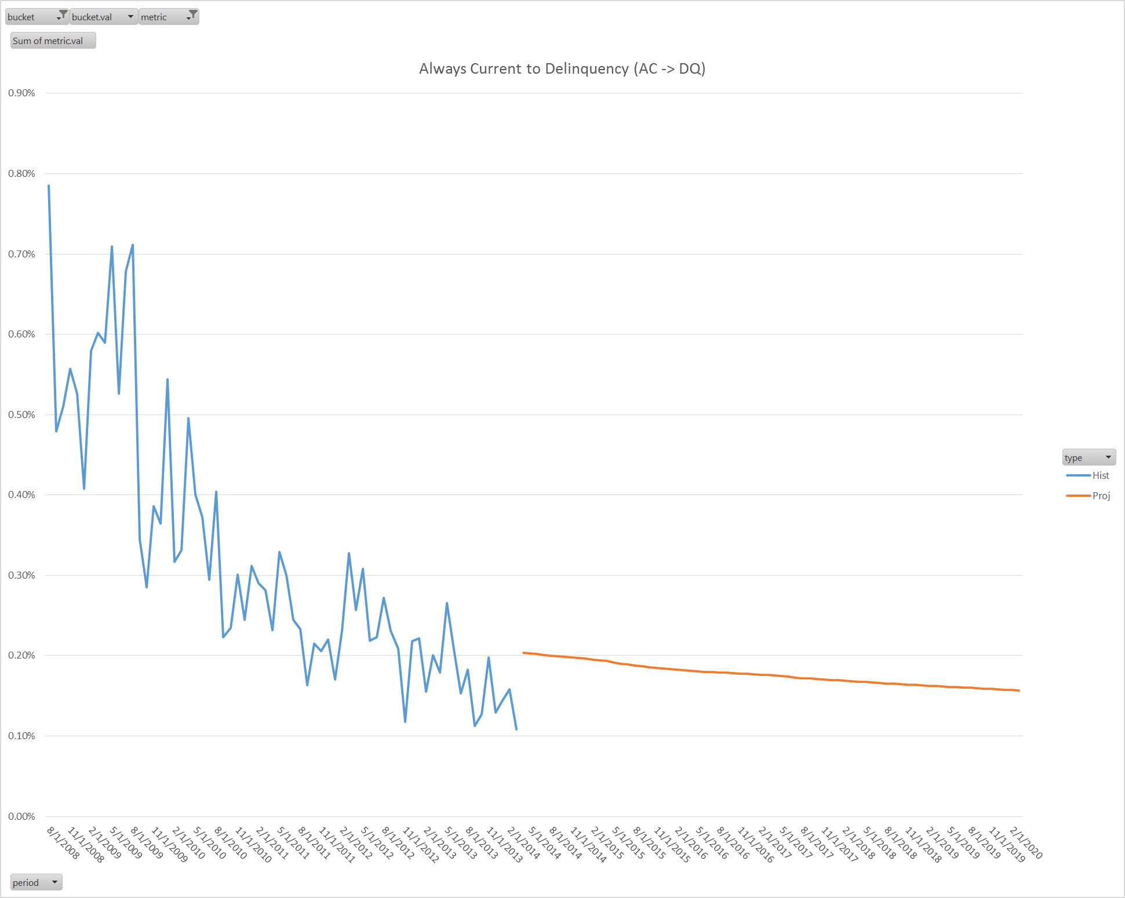
Model Projections
Always Current (AC) -> Delinquency rate is higher than most recent history would suggest

Slide 18
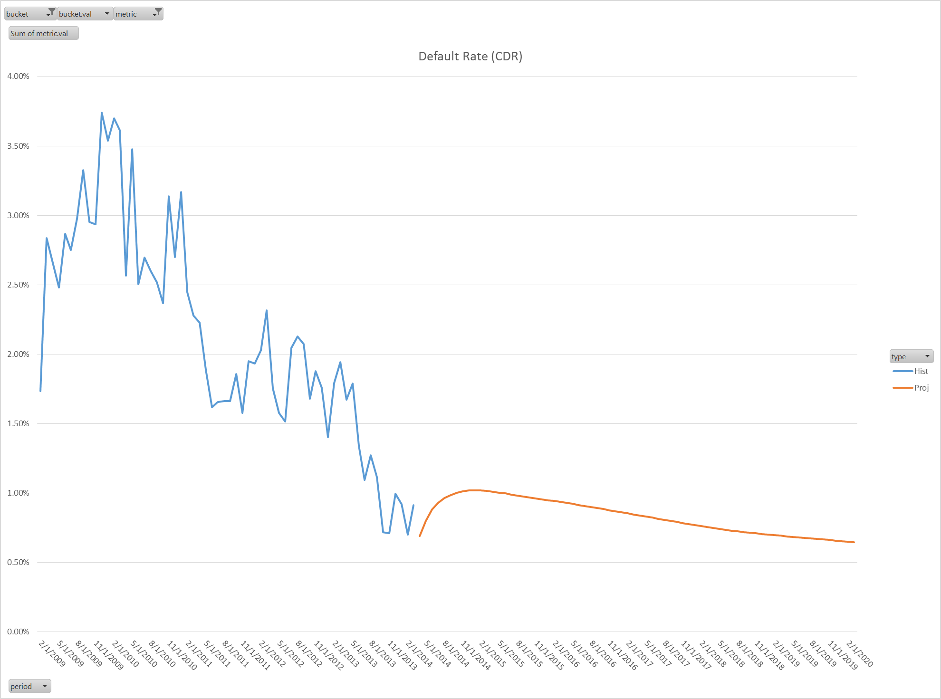
Model Projections
Default rates ramp slightly before decaying: likely due to higher Always Current (AC) to Delinquent rates than most recent history would suggest

Slide 19
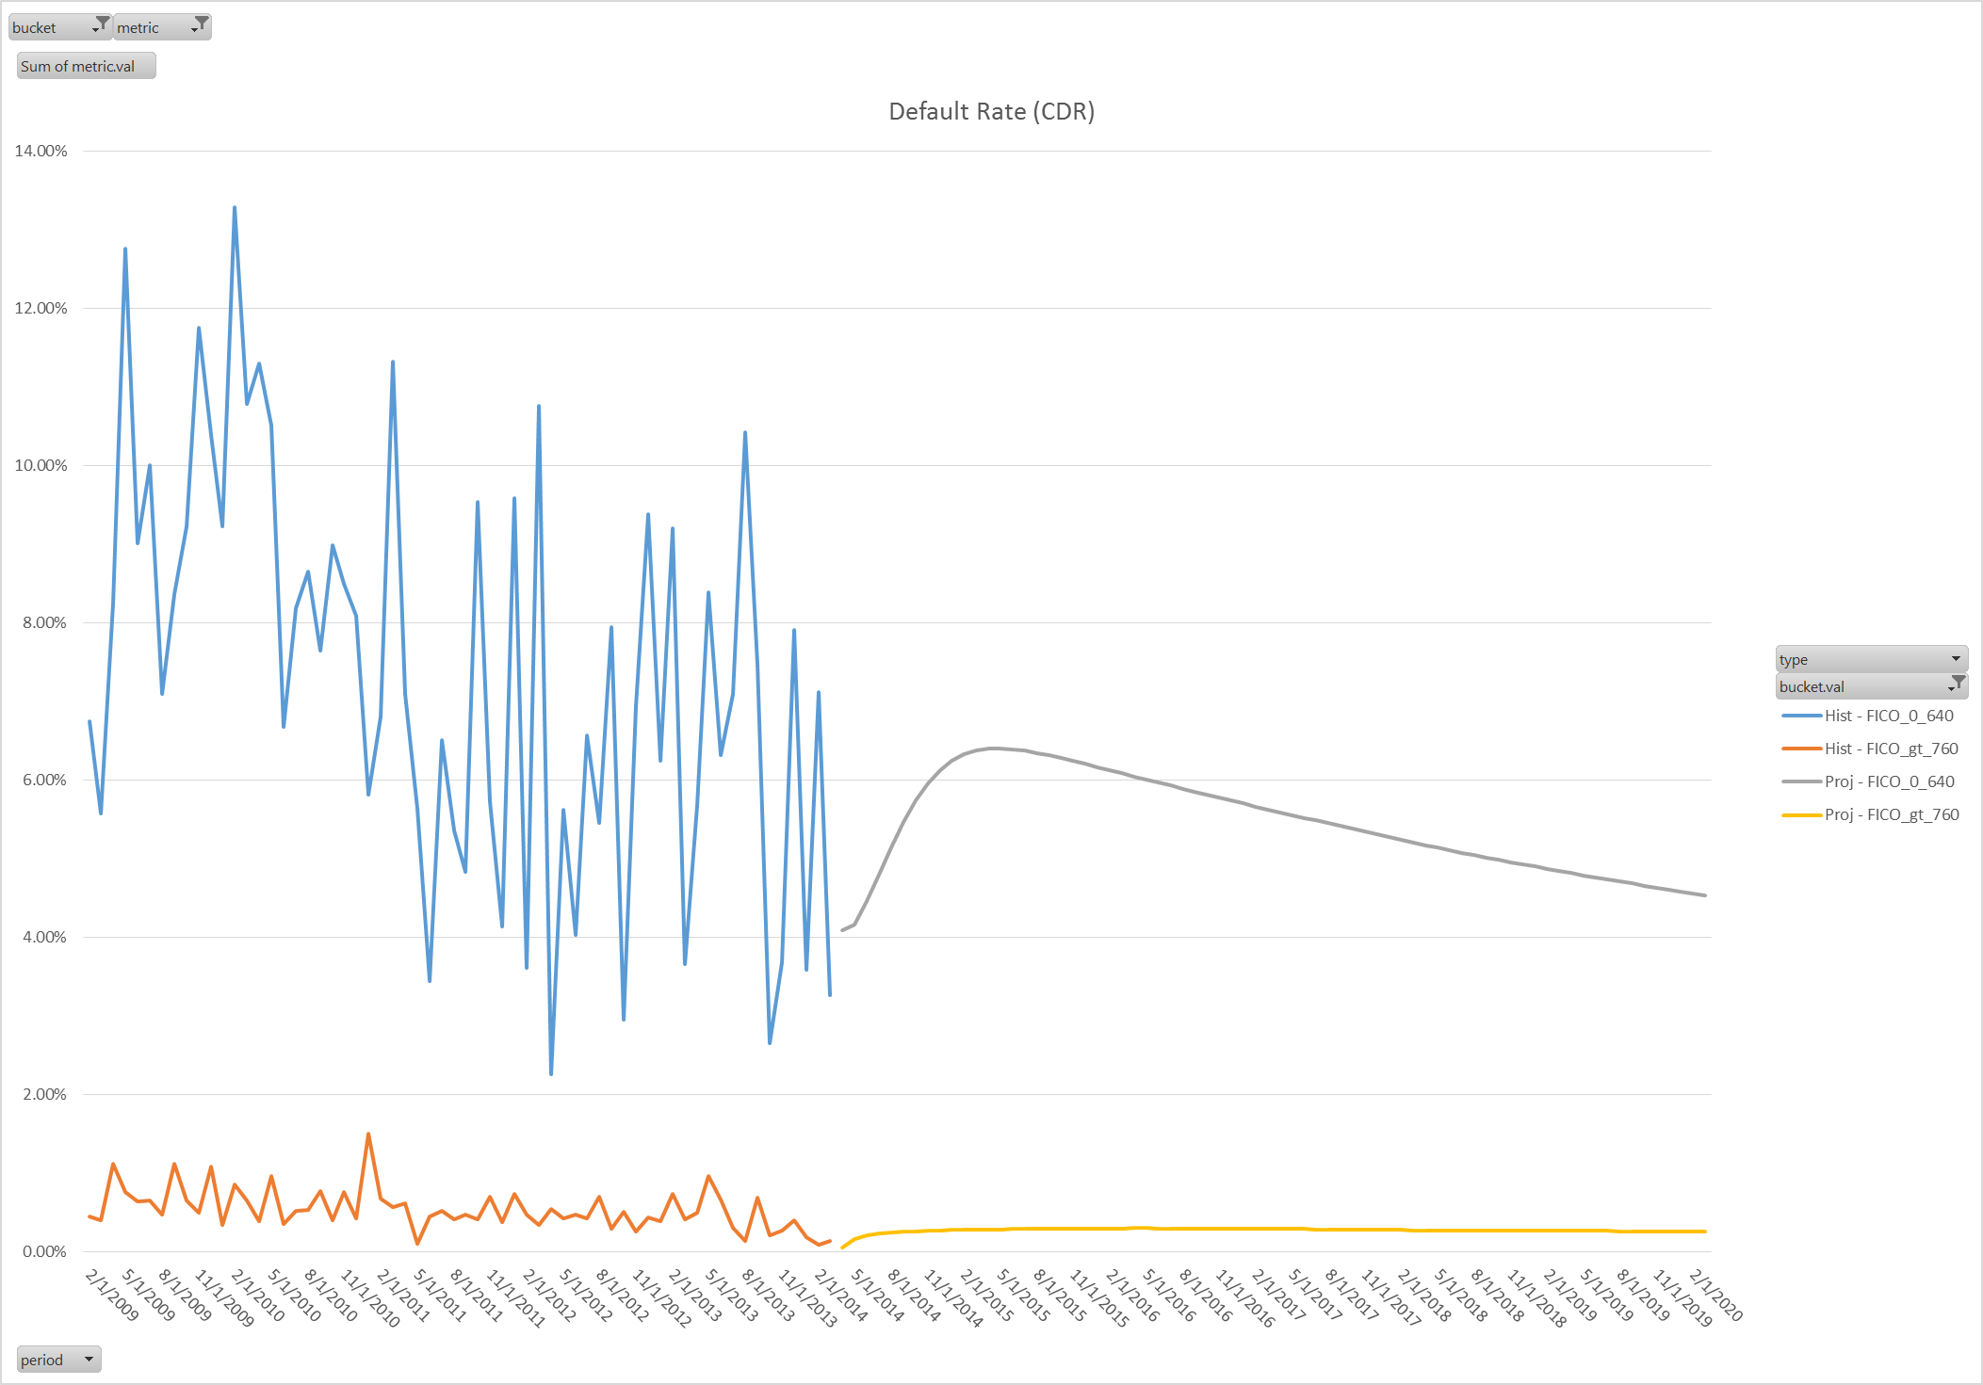
Model Projections (bucket by FICO)
FICO < 640
FICO > 760

Slide 20
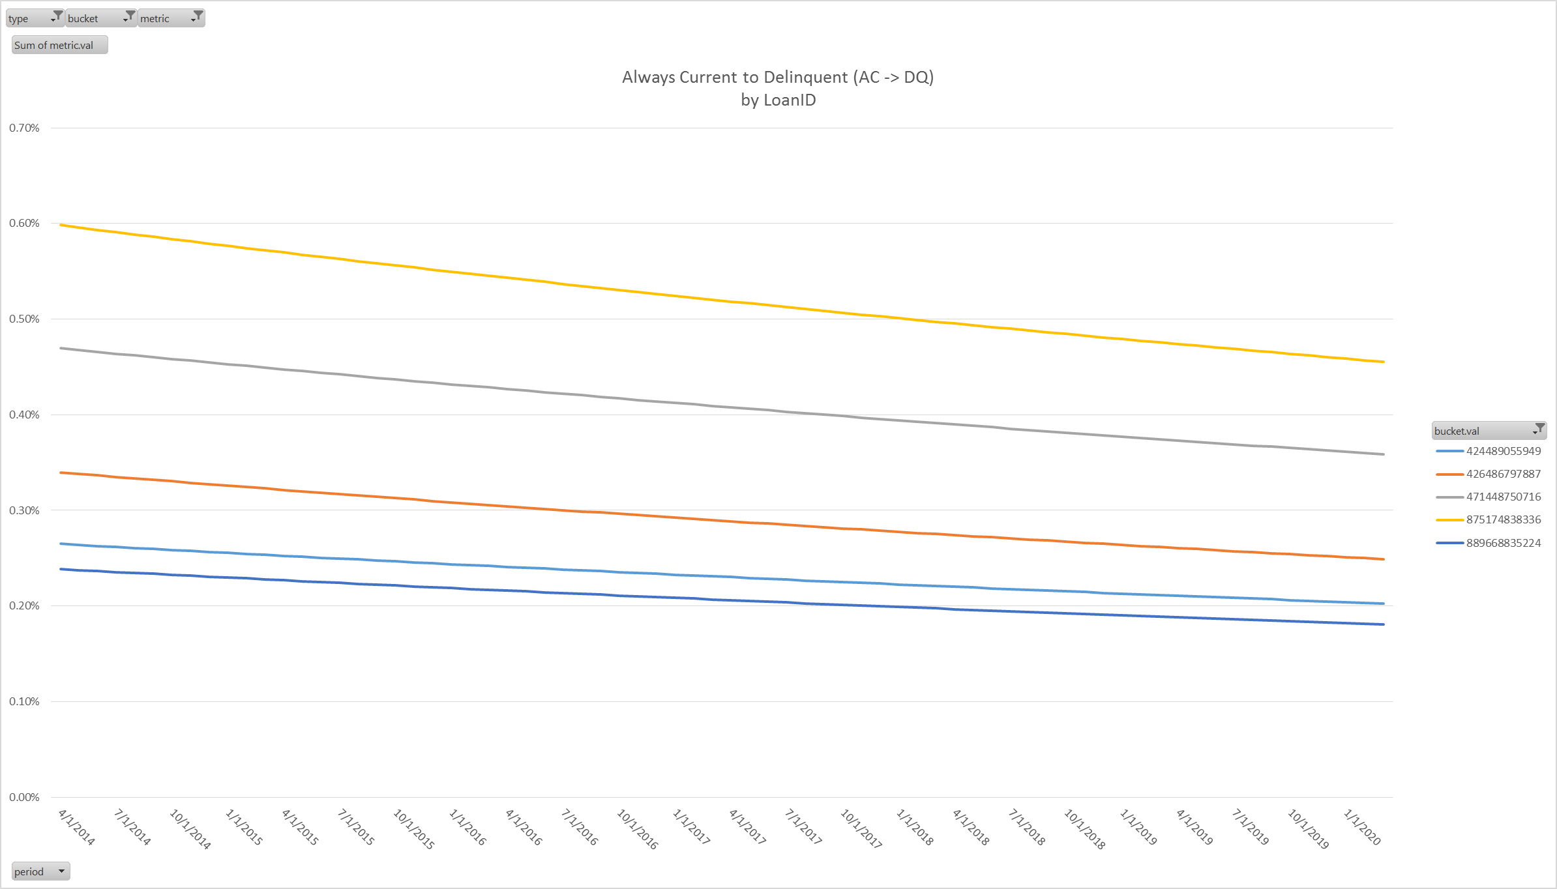
Model Projections (Loan Level)
5 Always Current loans as of Mar 2015

Slide 21
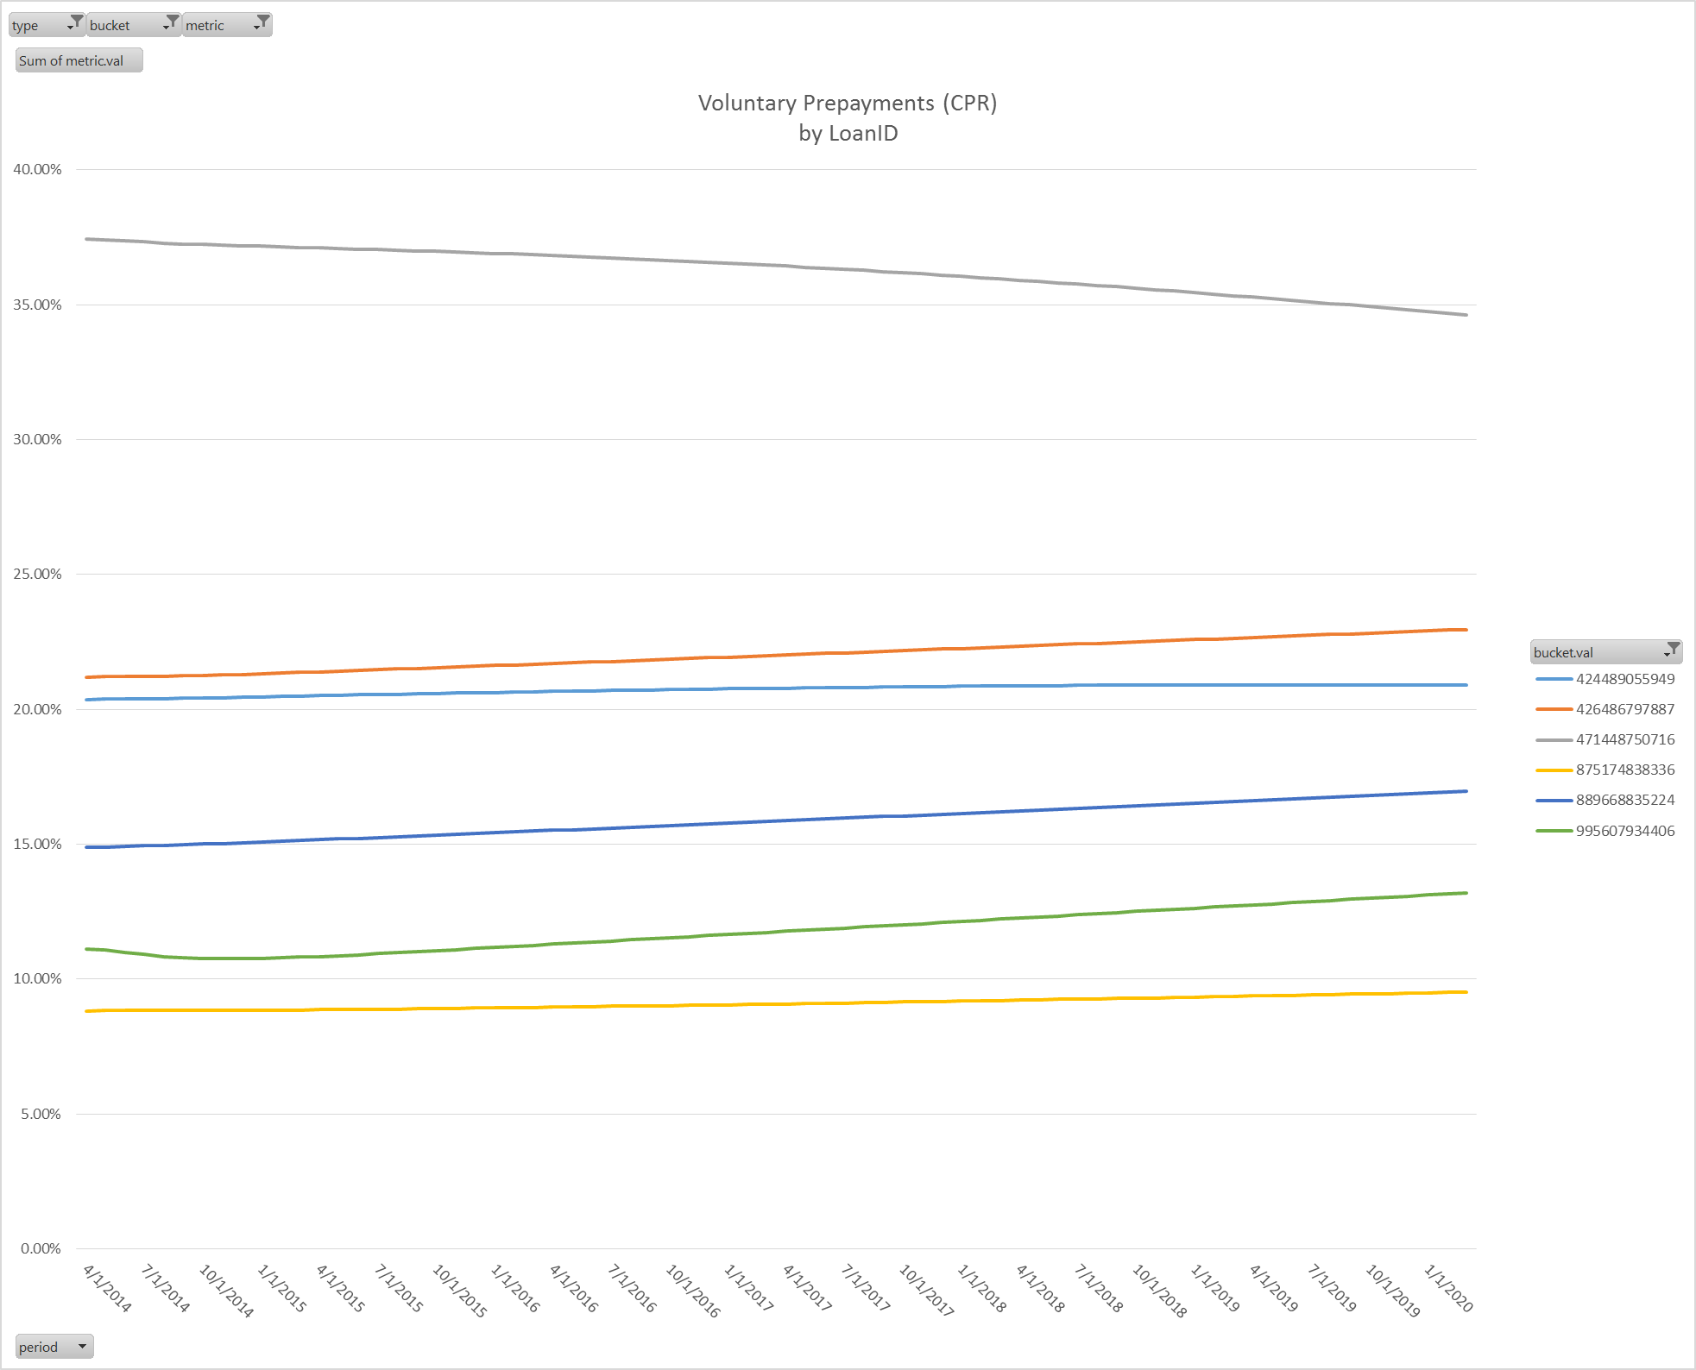
Model Projections (Loan Level)
Very high CPR due to Coupon ~8%

Slide 22
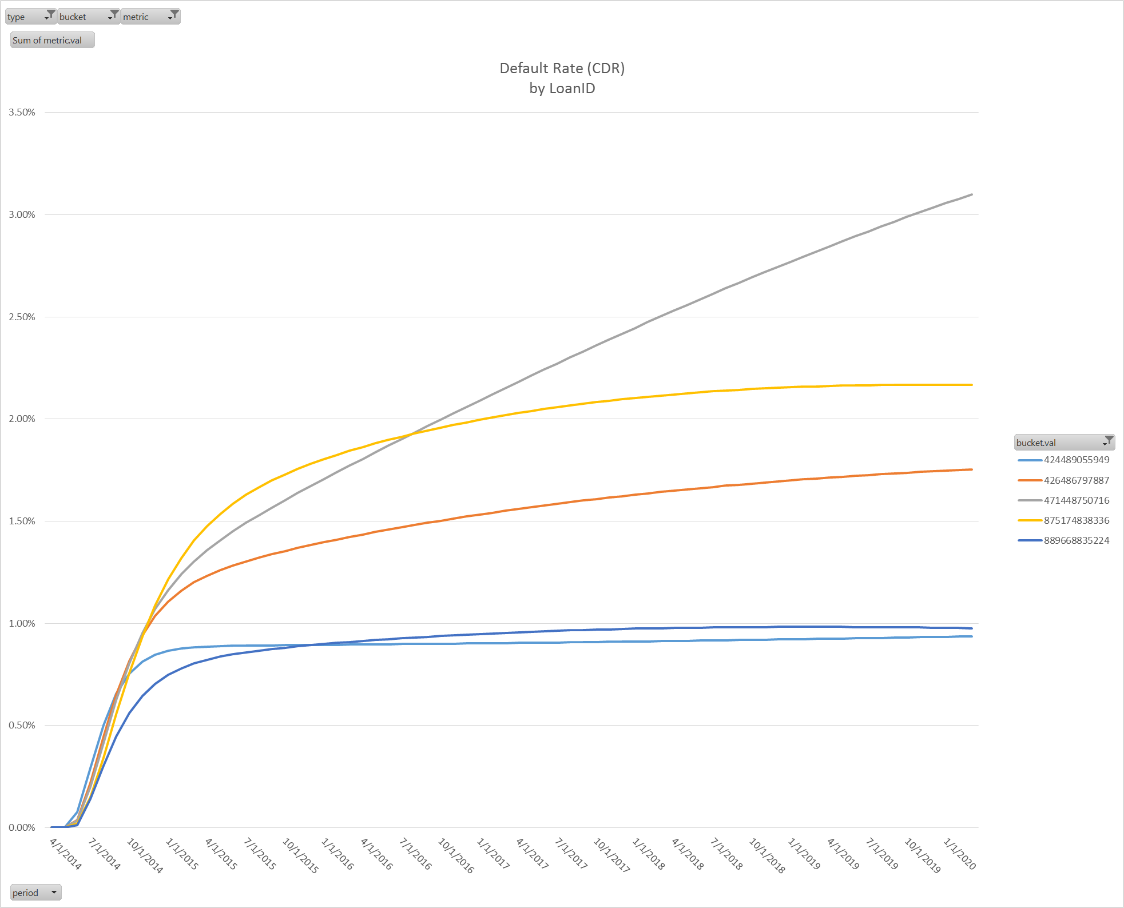
Model Projections (Loan Level)
Differently shaped CDR curve due to model interaction with high Coupon

Slide 23
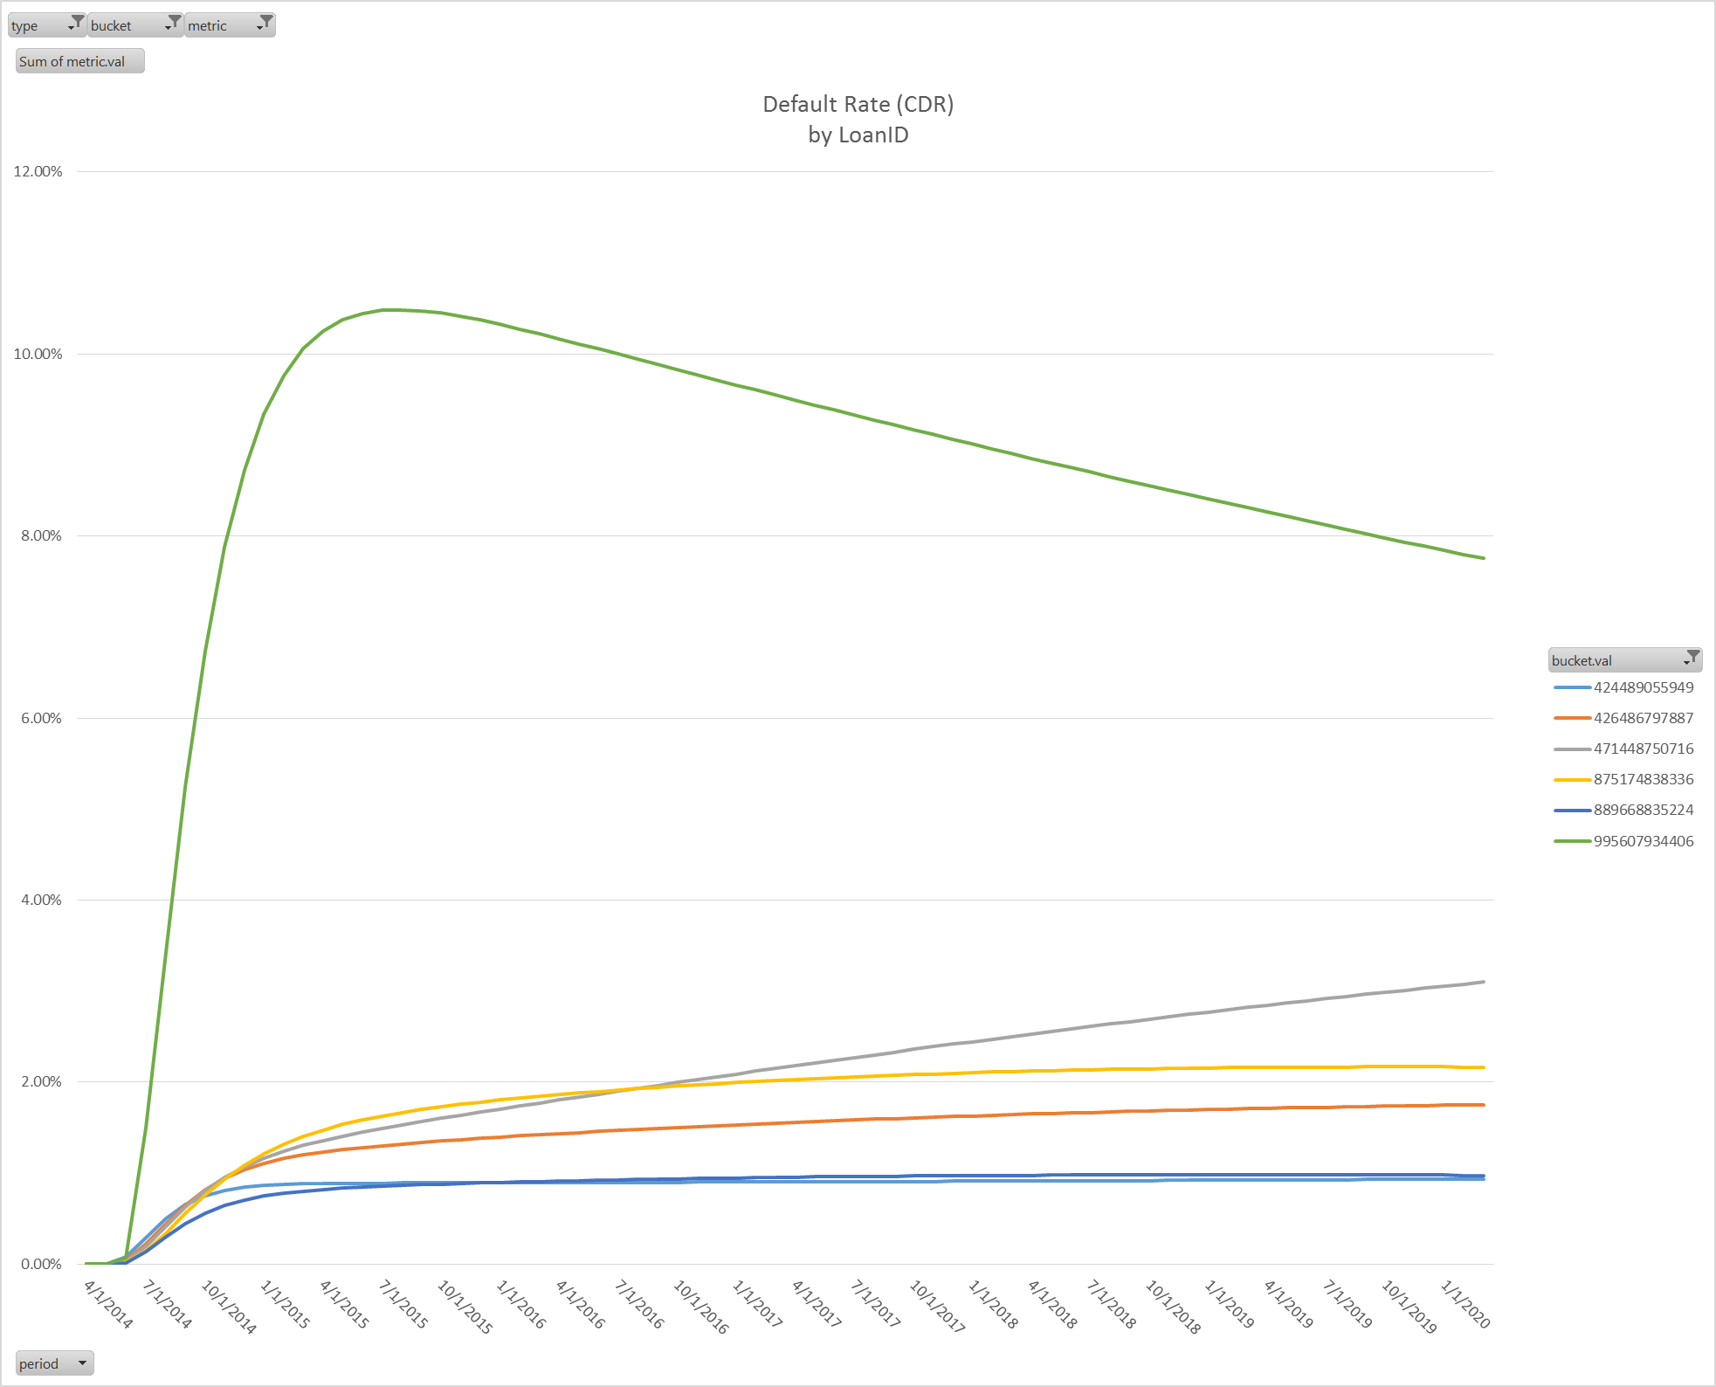
Model Projections (Loan Level)
Relative to a Dirty Current (DC) loan, the Always Current (AC) CDRs are much lower

Slide 24
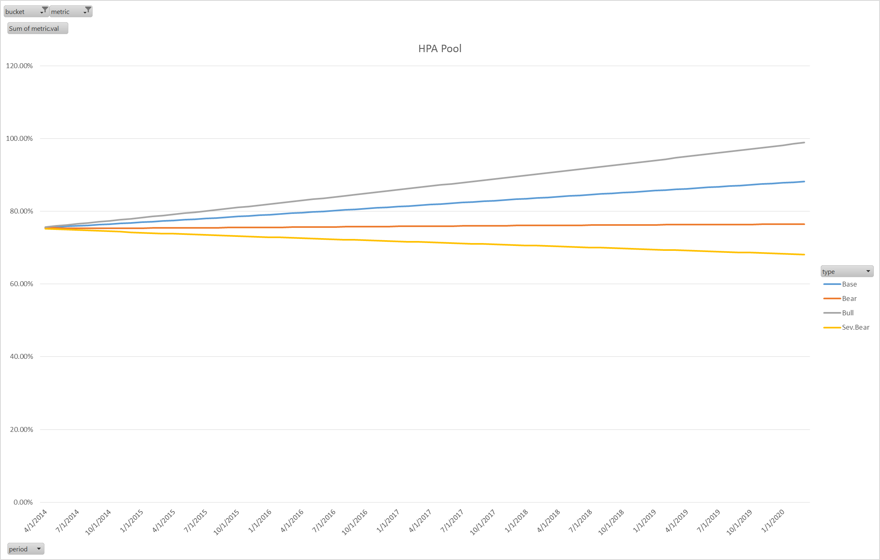
Model Projections (HPA Scenarios)
* Bull = 4.5% Increase / Year
* Base = 2.5% Increase / Year
* Bear = 0.0% Increase / Year
* Sev.Bear = 2.5% Decrease / Year

Slide 25
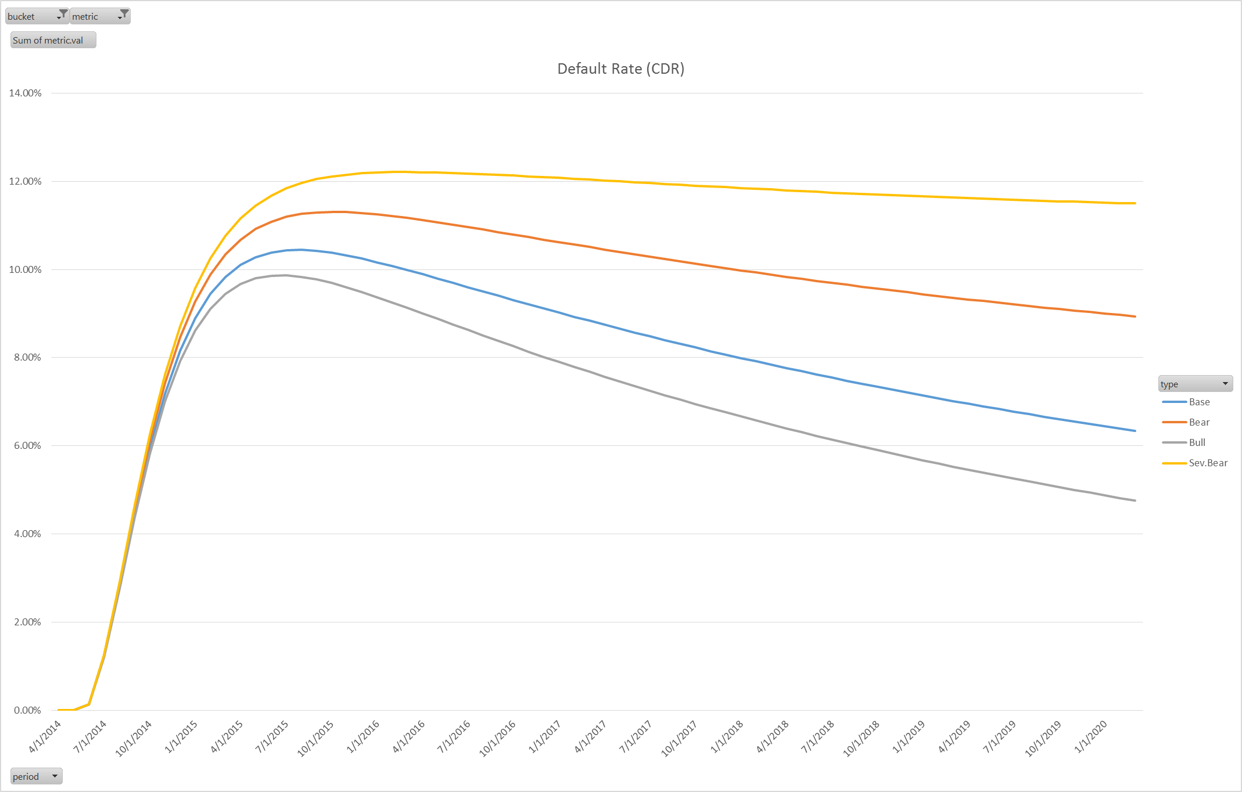
Model Projections (HPA Scenarios)
High dispersion of Defaults Rates given different HPA vectors

Slide 26
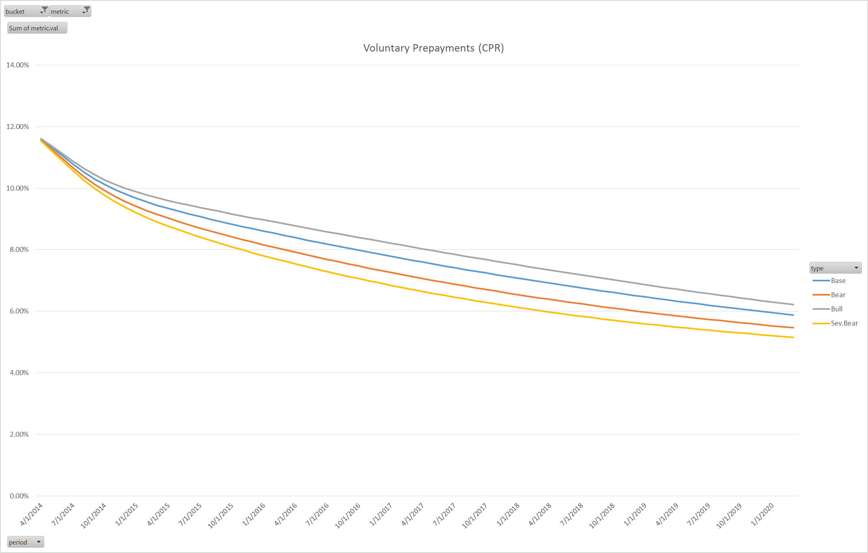
Model Projections (HPA Scenarios)
Lower dispersion of Prepayment Rates given different HPA vectors

Slide 27
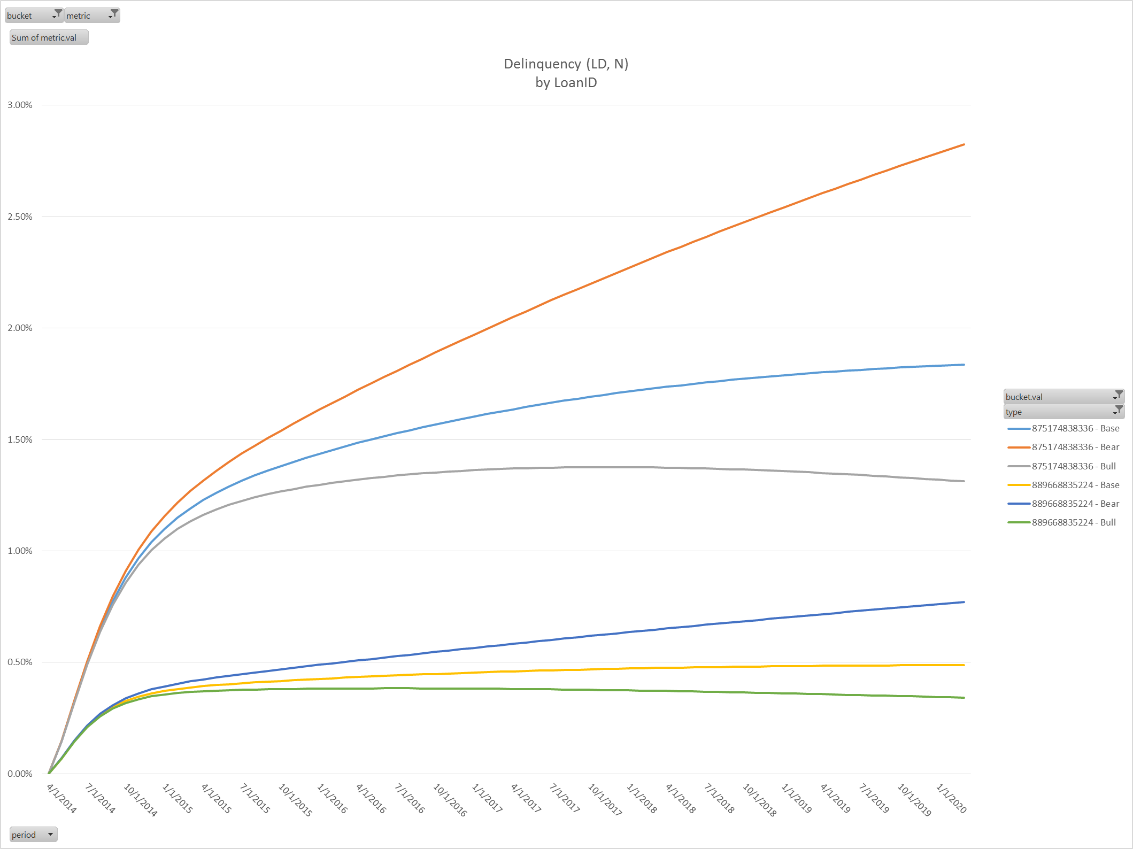
Model Projections (Loan Level x HPA Scenarios)
ID: 875174838336
ID: 889668835224

Slide 28
Going Forward: CAS/STACR Valuations
Next Steps
Calculate the loan characteristics of loans backing CAS and STACR deals
Loan level characteristics give greatest flexibility
Group level characteristics can also be used {Approximations Completed}
Automate the creation of “Rep-lines” from the loan level (or group level) data
Project these loans/rep-lines forward through time for analysis, pricing and risk
Option 1: Project at the loan level and store loan level vectors
Option 2: Project at the loan level and store grouped vectors
Option 3: Project each rep-line and store rep-line vectors
Integrate our projected vectors into a pricing/risk engine

Slide 29
Going Forward: Identifying Reference Loans for CRT Transactions
Each CRT Reference Pool has an acquisition window of 2-3 months
The acquisition windows are mutually exclusive
However GSE’s do not provide acquisition date in the loan level credit data
The origination date window of each reference pool is 6-7 months and overlaps between deals
Since we have Origination Date & not Acquisition Date from loan level data, we must make a guess at the actual loans backing a deal
We approximate mutually exclusive Origination windows based on the distribution of origination dates for every deal
We control for Fico, OLTV, CLTV, DTI, Coupon, Term based maximum & minimum values for every deal
We also exclude loans that have either been modified or have ever been delinquent as of the Cutoff Date for each deal
Based on the constraints above, we can closely replicate the pool characteristics for CRT deals:
Fico, Coupon, Original Balance, OLTV, CLTV, DTI, Loan Purpose, Property Type, Occupancy Status, Channel, Top 7 States
Note that we did not match Loan Count & Pool Balance

Slide 30
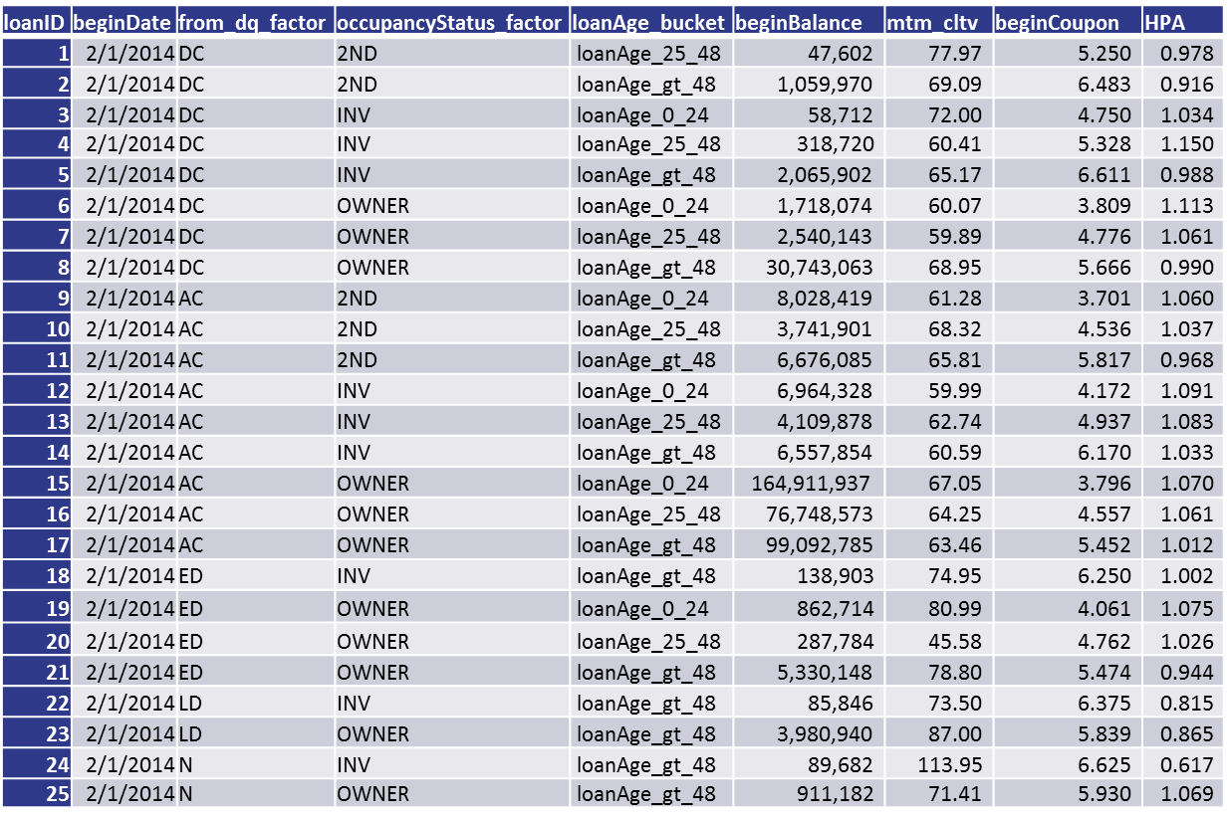
Going Forward: Rep-line Generation
Representative Loans or “rep-lines” can be produced automatically from the model characteristics, or from user input:
Ex) Transition Model uses Occupancy Status (Primary, Investor, 2nd) and Loan Age buckets (0-24 months, 24-48 months, 48+ months)

